Slide 1

Deepfake Detection Application
Members:
Fong Jin Xuan A24CS0074
Eii Zhi Hui A24CS0246
Qian Wen Jun A24CS4032
Lau Zhi Ying A24CS5020
Lee Jian Yi A24CS5075

Slide 2


Introduction
What is
design thinking?

Slide 3

Design thinking is an approach to problem-solving that is user-centric. It often involves five phases:
1: Empathize
Understanding target audience’s need and objectives
4: Prototype
Make a scale-down version product to test ideas
2: Define
Define core problem after gathering information
5: Test
Prototypes are tested by real users to gather feedback
3: Ideate
Brainstorm sessions to explore solutions

Slide 4

Related terms:
Big Data
A large diverse collection of structured, semi-structured and unstructured data that grows exponentially over time.

Slide 5
Related terms:
Artificial Intelligence
A technology that enable machines to simulate human intelligence such as learning, problem solving and comprehension

Slide 6



Phase 1: Empathize
We conducted a survey using Google Form to access digital devices users’ opinion towards deepfake technologies and used remaker.ai to try the latest deepfake technologies.
Before
Target face
After

Slide 7
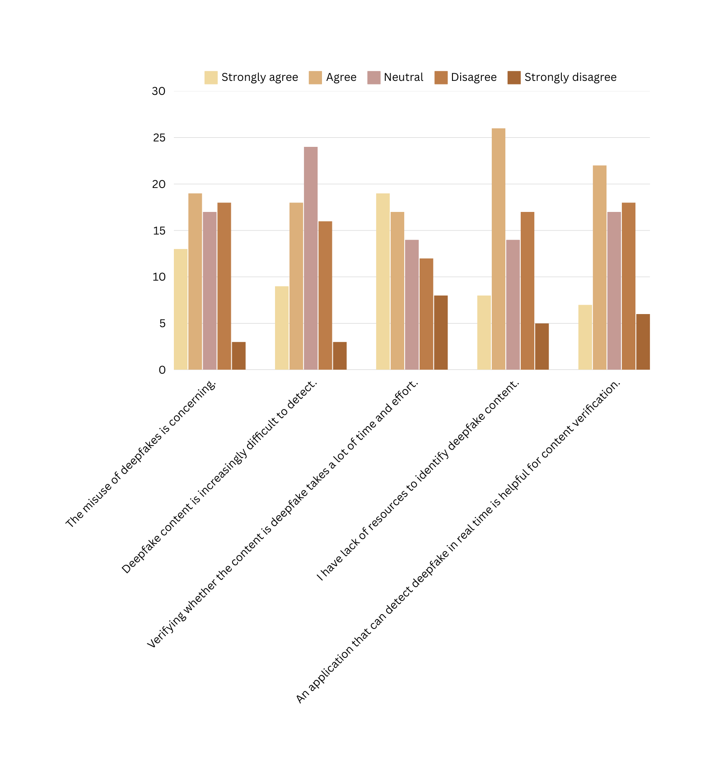
Phase 2:
Define
Data collected from Google Form is analyzed to identify users’ opinion.

Slide 8

From the survey form:
No. | Problems faced by users
1. | Deepfake content is difficult to detect
2. | Verifying deepfake content takes a lot of time and effort
3. | Lack of resources to identify deepfake content

Slide 9

Phase 3: Ideate
Several discussions and brainstorm sessions are held to find solutions.

Slide 10

Phase 4: Prototype
After coming out with the idea, a prototype is built using Figma.

Slide 11
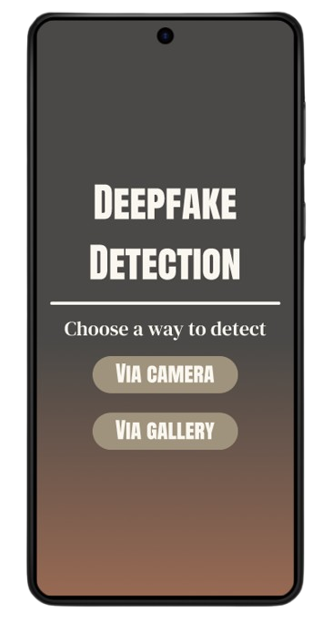
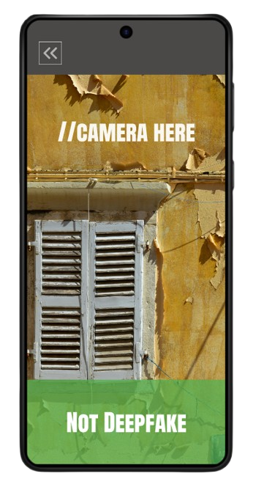

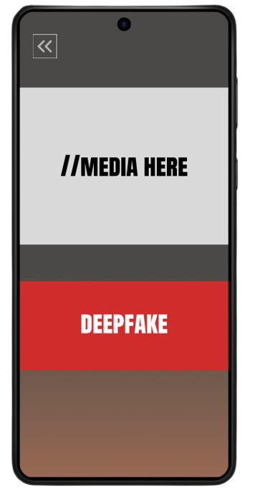
Application Prototype

Slide 12
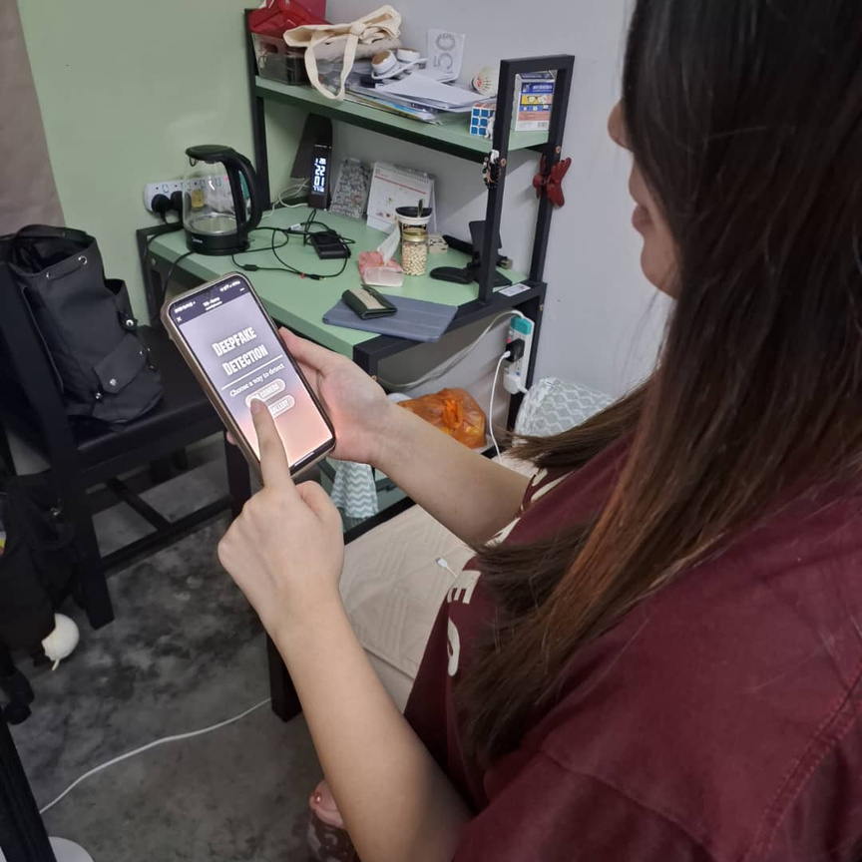
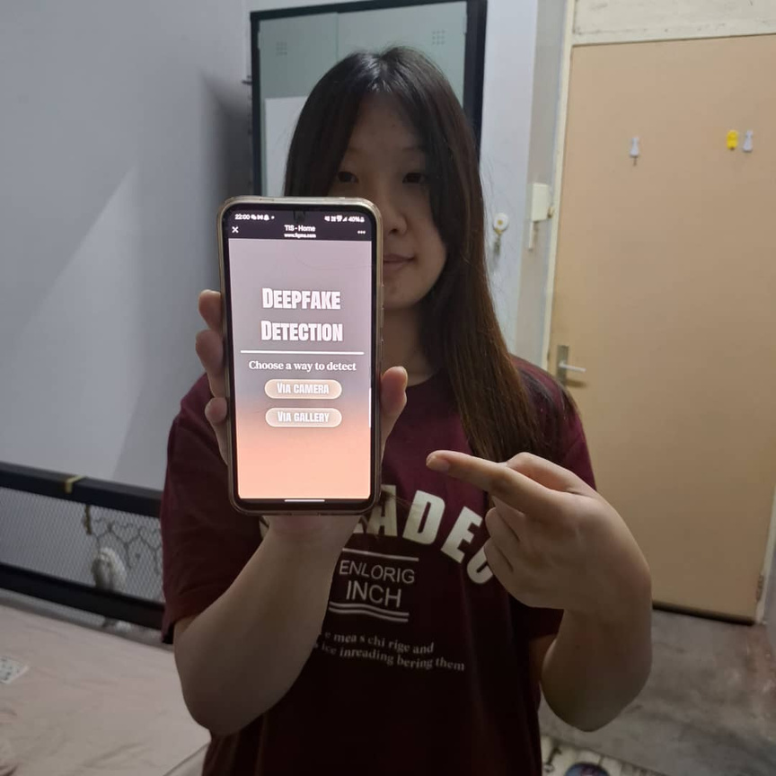
Phase 5: Test
Feedbacks from users are gathered.

Slide 13

Conclusion
We had the opportunity to design a product and produce relevant prototype from this project. We hope to benefit ourselves with this experience in our future projects and career.

Slide 14

Thank you!

